Slide 1

Big Data - Hadoop

Slide 2
Topics of the Day
What is Big Data?
Limitations of the existing solutions
Solving the problem with Hadoop
Introduction to Hadoop
Hadoop Eco-System
Hadoop Core Components
HDFS Architecture
MapReduce Job execution
Anatomy of a File Write and Read

Slide 3







What is Big Data?
Lots of Data (Terabytes or Petabytes)
Big data is the term for a collection of data sets so large and complex that it becomes difficult to process using on-hand database management tools or traditional data processing applications.
The challenges include capture, curation, storage, search, sharing, transfer, analysis, and visualization.
support
database
cloud
storage
tools
statistics
analyze
Big Data
information
No SQL
compression
mobile
processing
terabytes

Slide 4

What is Big Data?
Systems / Enterprises generate huge amount of data from Terabytes to and even Petabytes of information.
NYSE generates about one terabyte of new trade data per day to perform stock trading analytics to determine trends for optimal trades.

Slide 5
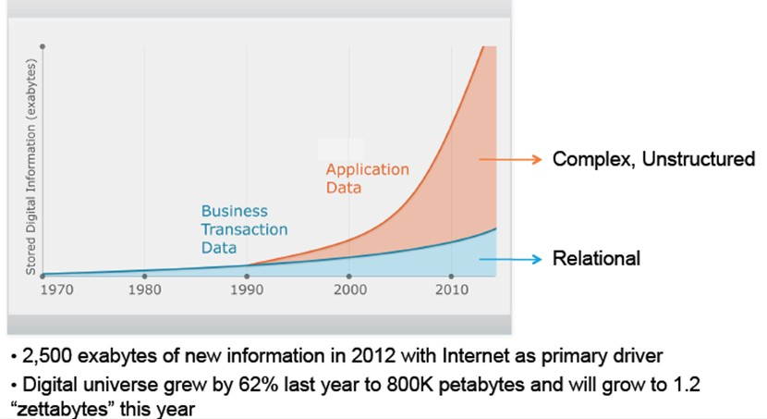
Un – Structured Data is Exploding

Slide 6














Web logs
Videos
Audios
Images
Sensor Data
Volume
Velocity
Variety

Slide 7



Annie’s Introduction
Hello There!!
My name is Annie.
I love quizzes and puzzles and I am here to make you guys think and answer my questions.

Slide 8



Annie’s Question
Map the following to corresponding data type:
XML Files
Word Docs, PDF files, Text files
E-Mail body
Data from Enterprise systems (ERP, CRM etc.)

Slide 9

Annie’s Answer
XML Files -> Semi-structured data
Word Docs, PDF files, Text files -> Unstructured Data
E-Mail body -> Unstructured Data
Data from Enterprise systems (ERP, CRM etc.) -> Structured Data

Slide 10

Further Reading
More on Big Data
http://www.Hadoop.in/blog/the-hype-behind-big-data/
Why Hadoop
http://www.Hadoop.in/blog/why-hadoop/
Opportunities in Hadoop
http://www.Hadoop.in/blog/jobs-in-hadoop/
Big Data
http://en.wikipedia.org/wiki/Big_Data
IBM’s definition – Big Data Characteristics
http://www-01.ibm.com/software/data/bigdata/

Slide 11


Common Big Data Customer Scenarios
Web and e-tailing
  Recommendation Engines
  Ad Targeting
  Search Quality
  Abuse and Click Fraud Detection
Telecommunications
  Customer Churn Prevention
  Network Performance Optimization
  Calling Data Record (CDR) Analysis
  Analyzing Network to Predict Failure
http://wiki.apache.org/hadoop/PoweredBy

Slide 12

Common Big Data Customer Scenarios(Contd.)
Government
  Fraud Detection and Cyber Security
  Welfare Schemes
  Justice
Healthcare & Life Sciences
  Health Information Exchange
  Gene Sequencing
  Serialization
  Healthcare Service Quality Improvements
  Drug Safety
http://wiki.apache.org/hadoop/PoweredBy

Slide 13


Common Big Data Customer Scenarios (Contd.)
Banks and Financial services
  Modeling True Risk
  Threat Analysis
  Fraud Detection
  Trade Surveillance
  Credit Scoring and Analysis
Retail
  Point of Sales Transaction Analysis
  Customer Churn Analysis
  Sentiment Analysis
http://wiki.apache.org/hadoop/PoweredBy

Slide 14






Hidden Treasure
Insight into data can provide Business Advantage.
Some key early indicators can mean Fortunes to Business.
More Precise Analysis with more data.
Case Study: Sears Holding Corporation
X
*Sears was using traditional systems such as Oracle Exadata, Teradata and SAS etc. to store and process the customer activity
and sales data.
Slide 17

Slide 15












Limitations of Existing Data Analytics Architecture
BI Reports + Interactive Apps
1. Can’t explore original high fidelity raw data
A meagre 10% of the
~2PB Data is available for BI
Processing
RDBMS (Aggregated Data)
ETL Compute Grid
90% of the ~2PB Archived
2. Moving data to compute doesn’t scale
Storage only Grid (original Raw Data)
3. Premature data
death
Storage
Mostly Append
Collection
Instrumentation
http://www.informationweek.com/it-leadership/why-sears-is-going-all-in-on-hadoop/d/d-id/1107038?

Slide 16









Solution: A Combined Storage Computer Layer
BI Reports + Interactive Apps
1. Data Exploration & Advanced analytics
RDBMS (Aggregated Data)
No Data Archiving
Entire ~2PB Data is available for processing
2. Scalable throughput for ETL &
aggregation
Hadoop : Storage + Compute Grid
3. Keep data alive forever
Mostly Append
Collection
Instrumentation
Both Storage And Processing
*Sears moved to a 300-Node Hadoop cluster to keep 100% of its data available for processing rather than a meagre 10% as was the case with existing Non-Hadoop solutions.

Slide 17




Hadoop Differentiating Factors
Accessible
Simple
Differentiating
Factors
Robust
Scalable

Slide 18
Hadoop – It’s about Scale and Structure
RDBMS
EDW
MPP
NoSQL
HADOOP
Structured | Data Types | Multi and Unstructured
Limited, No Data Processing | Processing | Processing coupled with Data
Standards & Structured | Governance | Loosely Structured
Required On write | Schema | Required On Read
Reads are Fast | Speed | Writes are Fast
Software License | Cost | Support Only
Known Entity | Resources | Growing, Complexities, Wide
Interactive OLAP Analytics Complex ACID Transactions Operational Data Store | Best Fit Use | Data Discovery Processing Unstructured Data Massive Storage/Processing

Slide 19




Why DFS?
Read 1 TB Data
1 Machine
4 I/O Channels
Each Channel – 100 MB/s
10 Machines
4 I/O Channels
Each Channel – 100 MB/s

Slide 20
Why DFS?
Read 1 TB Data
1 Machine
4 I/O Channels
Each Channel – 100 MB/s
10 Machines
4 I/O Channels
Each Channel – 100 MB/s
45 Minutes

Slide 21
Why DFS?
Read 1 TB Data
1 Machine
4 I/O Channels
Each Channel – 100 MB/s
10 Machines
4 I/O Channels
Each Channel – 100 MB/s
45 Minutes
4.5 Minutes

Slide 22

What is Hadoop?
Apache Hadoop is a framework that allows for the distributed processing of large data sets across clusters of commodity computers using a simple programming model.
It is an Open-source Data Management with scale-out storage & distributed processing.

Slide 23


Hadoop Key Characteristics
Reliable
Flexible
Hadoop
Features
Economical
Scalable

Slide 24

Annie’s Question
Hadoop is a framework that allows for the distributed processing of:
Small Data Sets
Large Data Sets

Slide 25

Annie’s Answer
Large Data Sets. It is also capable of processing small data-sets. However, to experience the true power of Hadoop, one needs to have data in TB’s. Because this is where RDBMS takes hours and fails whereas Hadoop does the same in couple of minutes.

Slide 26











Hadoop Eco-System
Apache Oozie (Workflow)
Hive
DW System
Pig Latin
Data Analysis
Mahout
Machine Learning
MapReduce Framework
HBase
HDFS (Hadoop Distributed File System)
Flume Sqoop
Import Or Export
Unstructured or
Semi-Structured data
Structured Data

Slide 27








Machine Learning with Mahout
Write intelligent applications using Apache Mahout
LinkedIn Recommendations
Hadoop and MapReduce magic in action
https://cwiki.apache.org/confluence/display/MAHOUT/Powered+By+Mahout

Slide 28
Hadoop Core Components
Hadoop is a system for large scale data processing. It has two main components:
HDFS – Hadoop Distributed File System (Storage)
  Distributed across “nodes”
  Natively redundant
  NameNode tracks locations.
MapReduce (Processing)
  Splits a task across processors
  “near” the data & assembles results
  Self-Healing, High Bandwidth
  Clustered storage
  JobTracker manages the TaskTrackers

Slide 29













Hadoop Core Components ( Contd.)
MapReduce Engine
Job Tracker
Task Tracker
Task Tracker
Task Tracker
Task Tracker
HDFS
Cluster
Admin Node
Name node
Data Node
Data Node
Data Node
Data Node

Slide 30
















HDFS Architecture
Metadata ops
NameNode
Metadata (Name, replicas,…):
/home/foo/data, 3,…
Client
Block ops
Read
DataNodes
DataNodes
Replication
Blocks
Write
Rack 1
Client
Rack 2

Slide 31


Main Components of HDFS
NameNode:
  Master of the system
  Maintains and manages the blocks which are present on the DataNodes
DataNodes:
  Slaves which are deployed on each machine and provide the actual storage
  Responsible for serving read and write requests for the clients

Slide 32



NameNode Metadata
Meta-data in Memory
  The entire metadata is in main memory
  No demand paging of FS meta-data
Types of Metadata
  List of files
  List of Blocks for each file
  List of DataNode for each block
  File attributes, e.g. access time, replication factor
A Transaction Log
  Records file creations, file deletions. etc
NameNode (Stores metadata only)
METADATA:
/user/doug/hinfo -> 1 3 5
/user/doug/pdetail -> 4 2
NameNode:
Keeps track of overall file directory structure and the placement of Data Block

Slide 33















Secondary NameNode
metadata
Single Point Failure
NameNode
Secondary NameNode:
  Not a hot standby for the NameNode
  Connects to NameNode every hour*
  Housekeeping, backup of NemeNode metadata
  Saved metadata can build a failed NameNode
You give me metadata every hour, I will make it secure
Secondary NameNode
metadata

Slide 34

Annie’s Question
NameNode?
is the “Single Point of Failure” in a cluster
runs on ‘Enterprise-class’ hardware
stores meta-data
All of the above

Slide 35

Annie’s Answer
All of the above. NameNode stores meta-data and runs on reliable high quality hardware because it’s a Single Point of failure in a Hadoop Cluster.

Slide 36

Annie’s Question
When the NameNode fails, Secondary NameNode takes over instantly and prevents Cluster Failure:
TRUE
FALSE

Slide 37

Annie’s Answer
False. Secondary NameNode is used for creating NameNode checkpoints. NameNode can be manually recovered using ‘edits’ and ‘FSImage’ stored in Secondary NameNode. This will be explained in more detail in Module-3.

Slide 38












JobTracker
1. Copy Input Files
DFS
Job.xml. Job.jar.
Input Files
3. Get Input Files’ Info
Client
5. Upload Job Information
2. Submit Job
4. Create Splits
User
6. Submit Job
Job Tracker

Slide 39





JobTracker ( Contd.)
DFS
As many maps as splits
Input Spilts
Job.xml.
Job.jar.
Client
8. Read Job Files
Maps
Reduces
Job Tracker
6. Submit Job
9. Create maps and reducers
7. Initialize Job
Job Queue

Slide 40








JobTracker ( Contd.)
Job Tracker
Job Queue
H1
H3
H4
11. Picks Tasks
(Data Local if possible)
10. Heartbeat
H5
Task Tracker - H2
Task Tracker -
H1
10. Heartbeat
12. Assign Tasks
10. Heartbeat
Task Tracker - H3
10. Heartbeat
Task Tracker -
H4

Slide 41

Annie’s Question
Hadoop framework picks which of the following daemon for scheduling a task ?
namenode
datanode
task tracker
job tracker

Slide 42
Annie’s Answer
JobTracker takes care of all the job scheduling and assign tasks to TaskTrackers.

Slide 43









Anatomy of A File Write
2. Create
NameNode
HDFS
Client
1. Create
3. Write
Distributed File System
NameNode
7. Complete
6. Close
4. Write Packet
5. ack Packet
4
4
Pipeline of Data nodes
DataNode
DataNode
DataNode
DataNode
5
DataNode
5
DataNode

Slide 44



Anatomy of A File Read
1. Open
2. Get Block locations
Distributed File System
NameNode
HDFS
Client
3. Read
NameNode
6. Close
Client JVM
Client Node
FS Data Input Stream
4. Read
5. Read
DataNode
DataNode
DataNode
DataNode
DataNode
DataNode

Slide 45
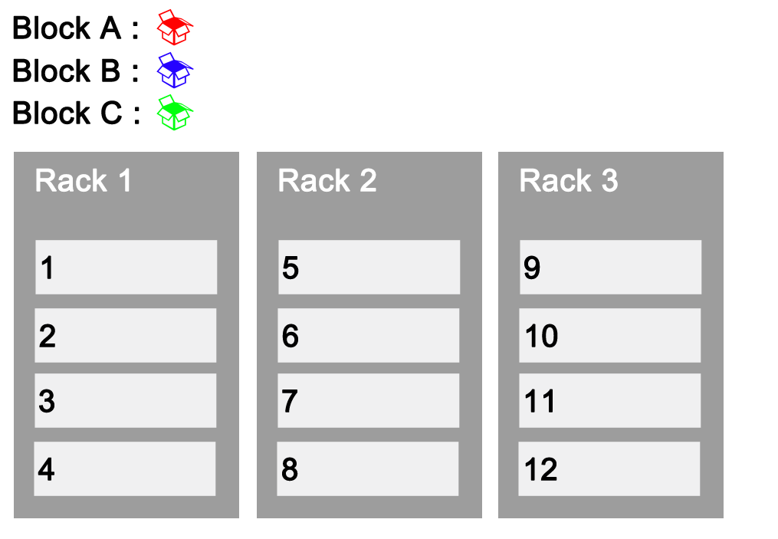




Replication and Rack Awareness

Slide 46

Annie’s Question
In HDFS, blocks of a file are written in parallel, however the replication of the blocks are done sequentially:
TRUE
FALSE

Slide 47

Annie’s Answer
True. A files is divided into Blocks, these blocks are written in parallel but the block replication happen in sequence.

Slide 48


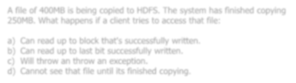
Annie’s Question
A file of 400MB is being copied to HDFS. The system has finished copying 250MB. What happens if a client tries to access that file:
Can read up to block that's successfully written.
Can read up to last bit successfully written.
Will throw an throw an exception.
Cannot see that file until its finished copying.

Slide 49

Annie’s Answer
Answer is (a)
Client can read up to the successfully written data block.

Slide 50
Further Reading
Apache Hadoop and HDFS
http://www.Hadoop.in/blog/introduction-to-apache-hadoop-hdfs/
Apache Hadoop HDFS Architecture
http://www.Hadoop.in/blog/apache-hadoop-hdfs-architecture/

Slide 51
Pre-work
  Hadoop Installation – Setup Cloudera CDH3 Demo VM
  Execute Linux Basic Commands
  Execute HDFS Hands On commands

Slide 52
Thank You
See You in Next Class

